Slide 1
Getting More Pilots
By: Brian Jankowitz

Slide 2
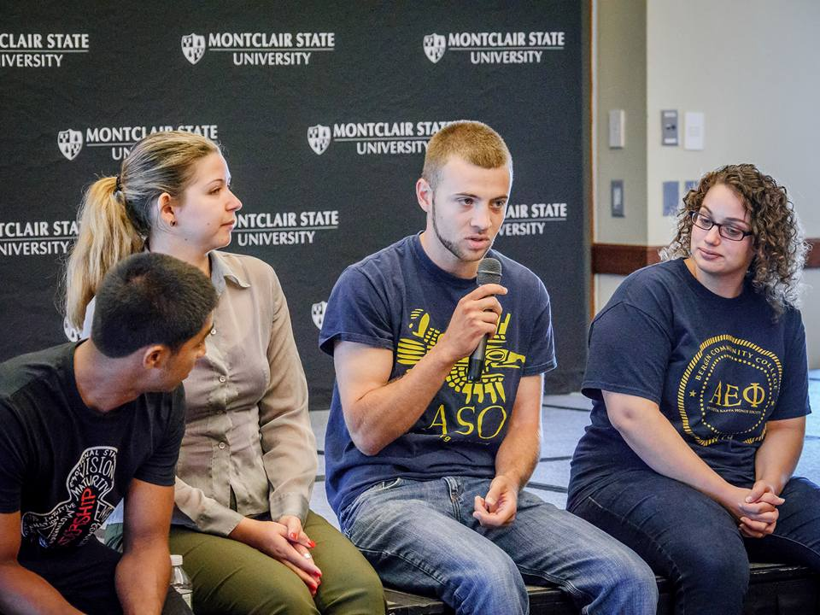

Slide 3
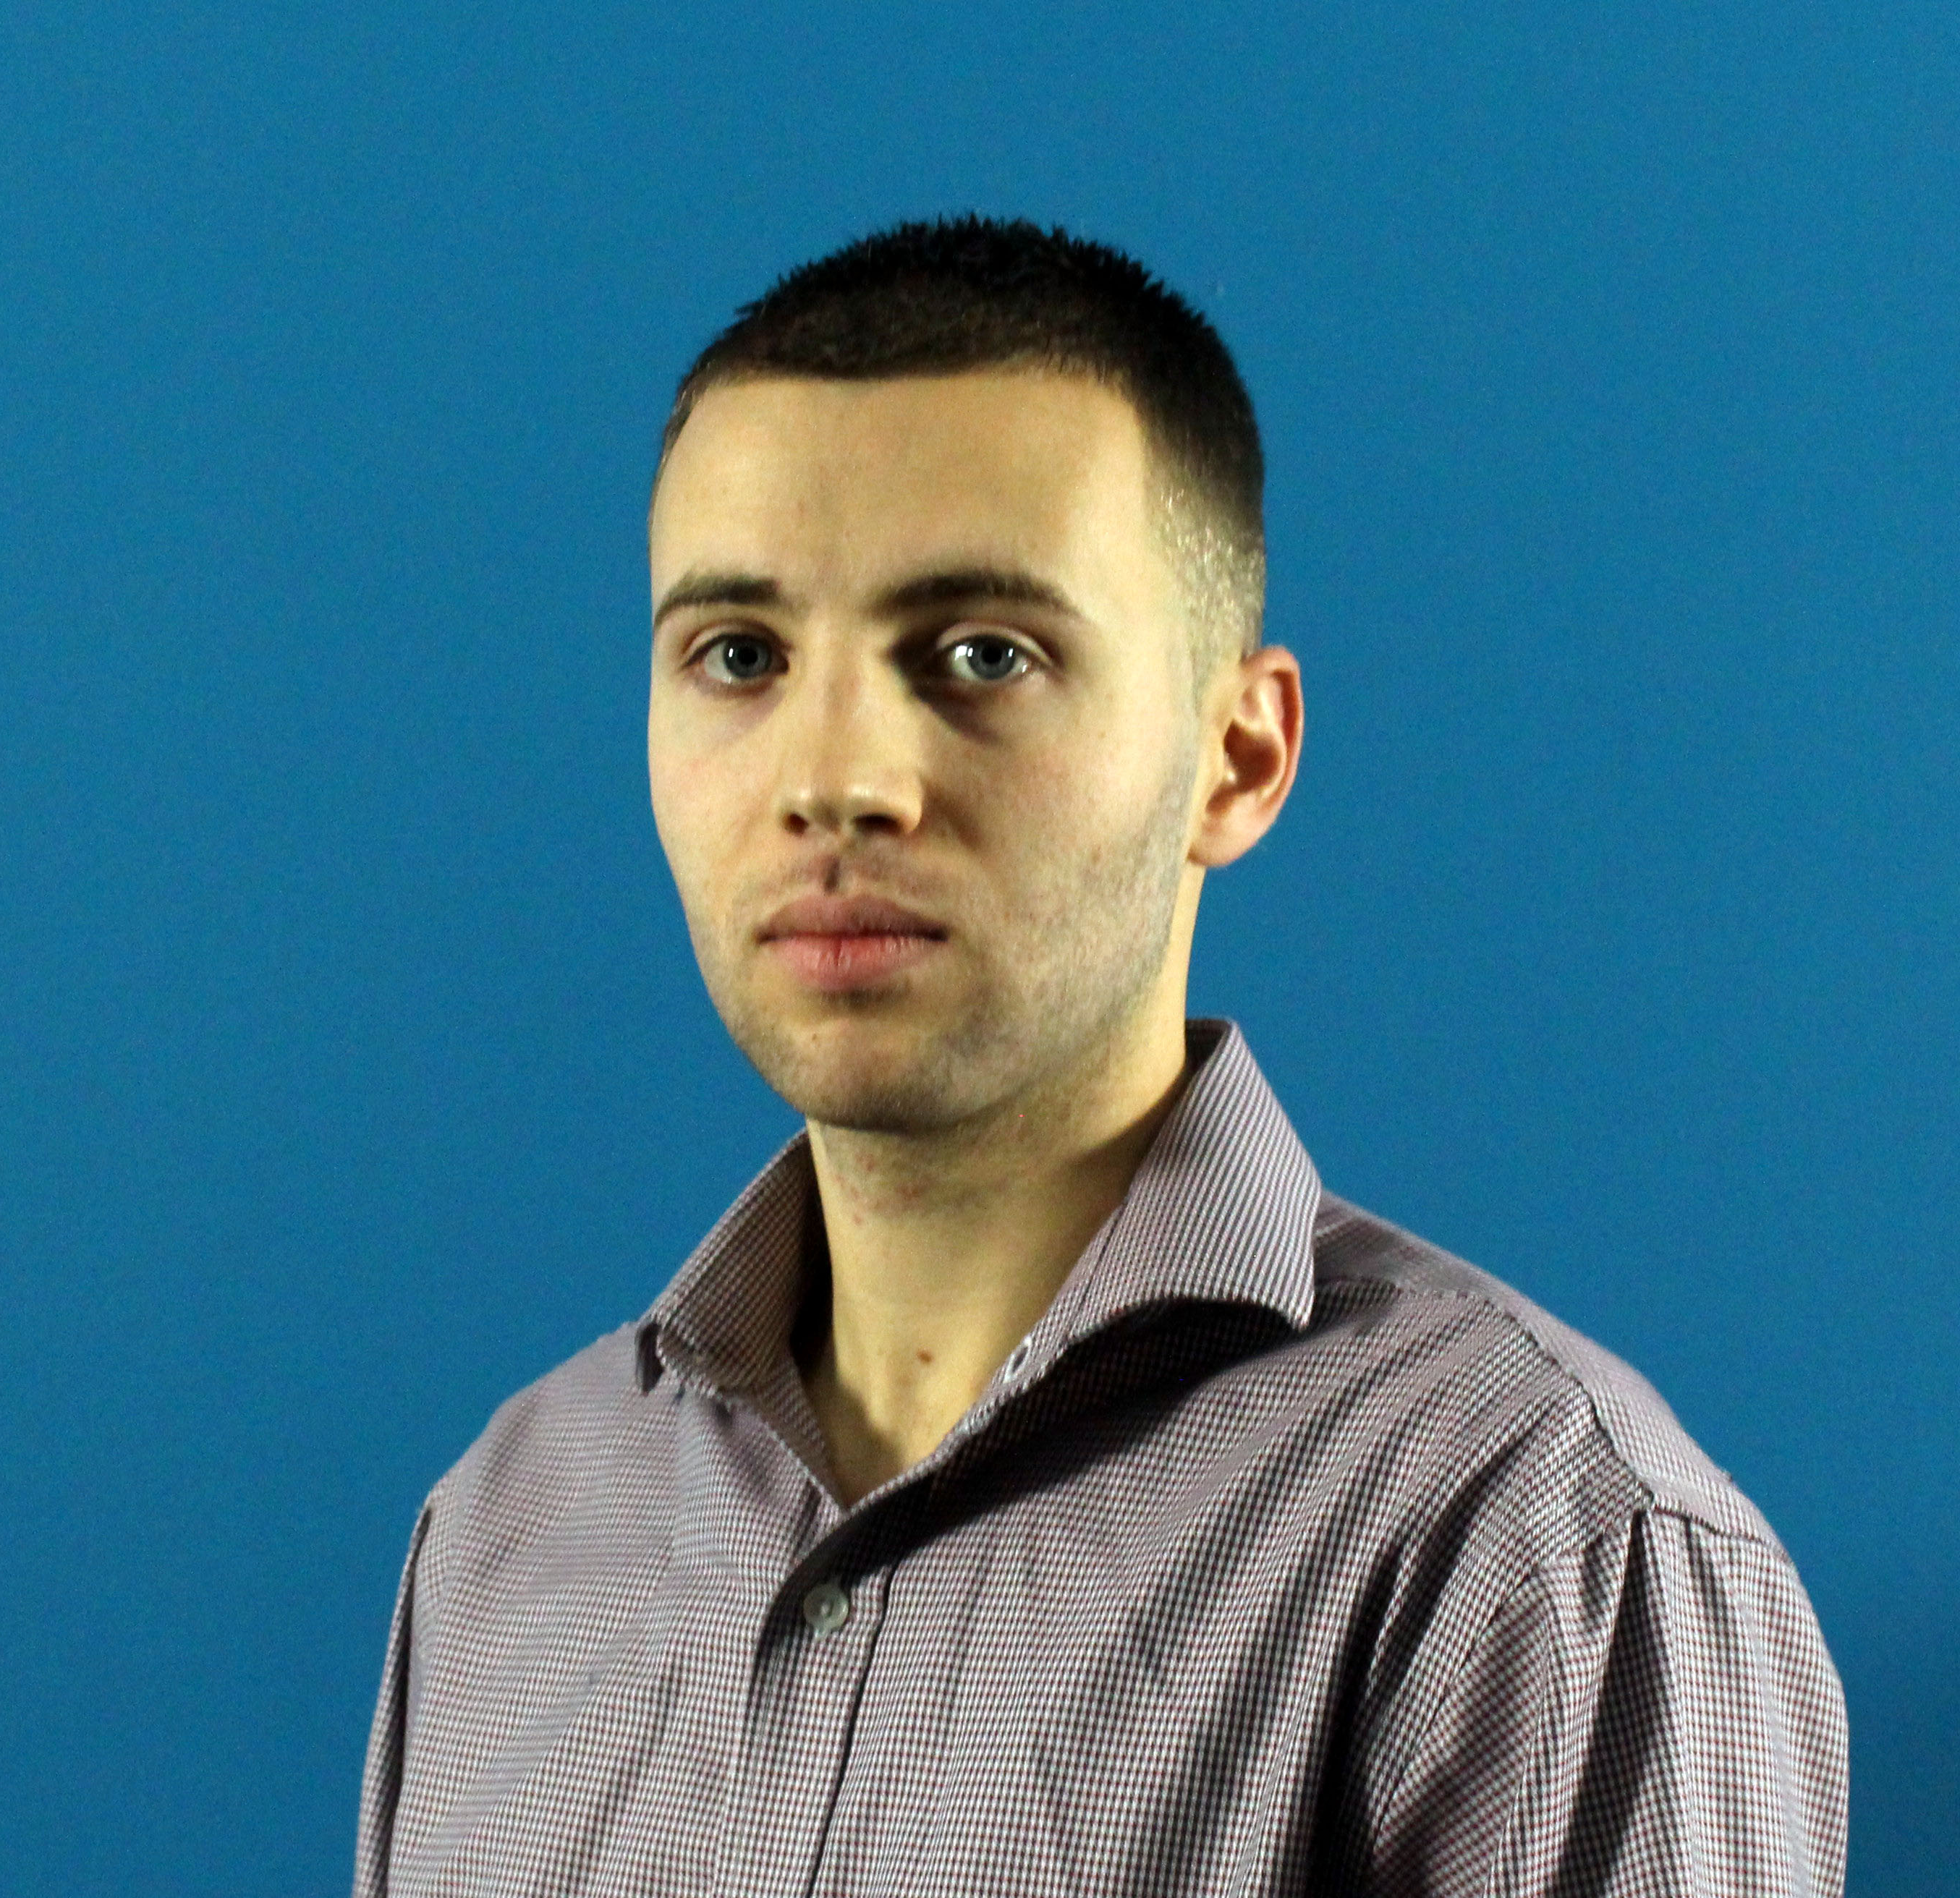
Brian Jankowitz
Data Analyst
Presented in front of audiences 300+ people
Background in aviation, recruitment, and data analyzation

Slide 4




Agenda
Airline Pilot Shortage
Getting More Pilots
Marketing

Slide 5
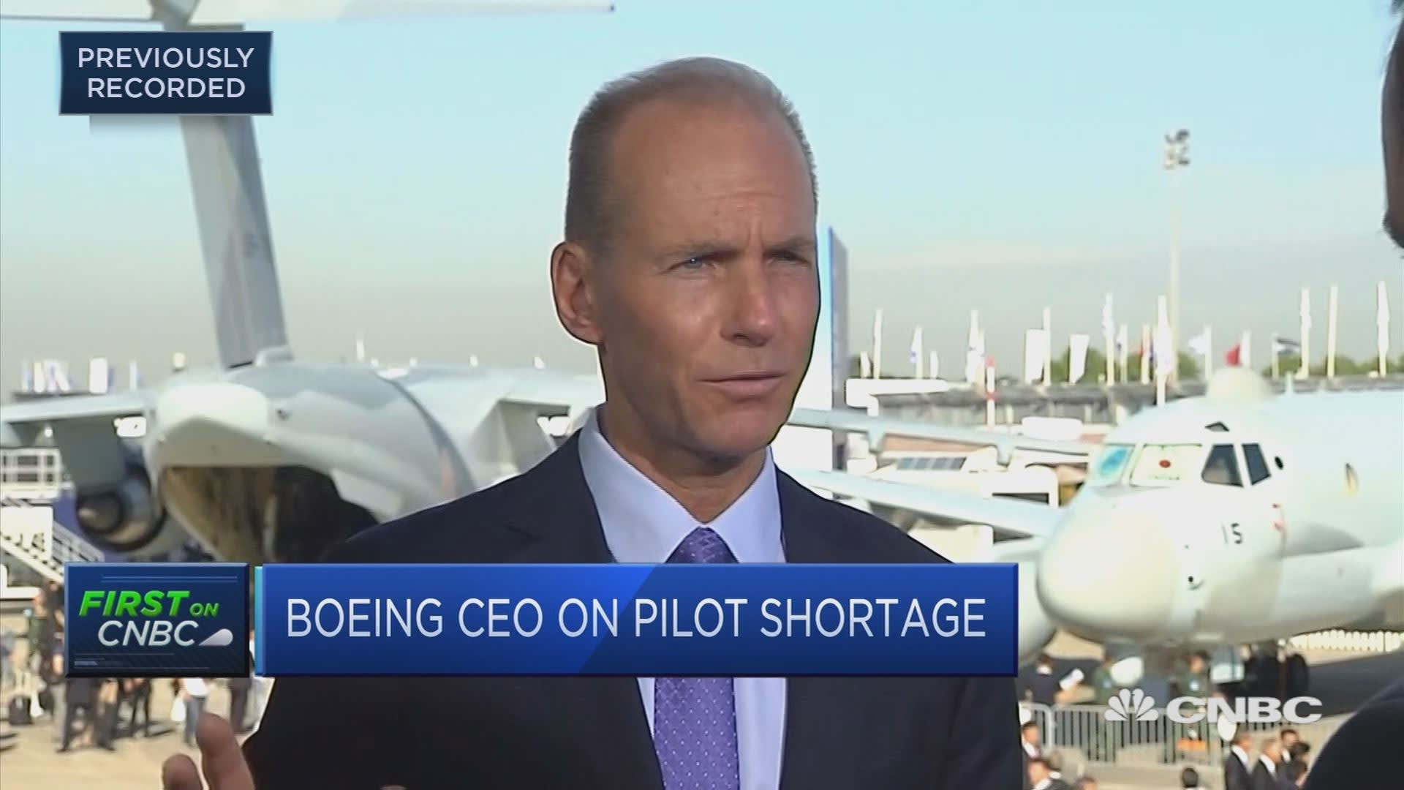
Airline Pilot Shortage Facts
Mandatory retirement age
Aircraft fleet are increasing
Air Travel expected to double in 20 years
1500 hours for Airline Transport Pilot License (250 before)
800,000 new pilots needed in the next 20 years

Slide 6
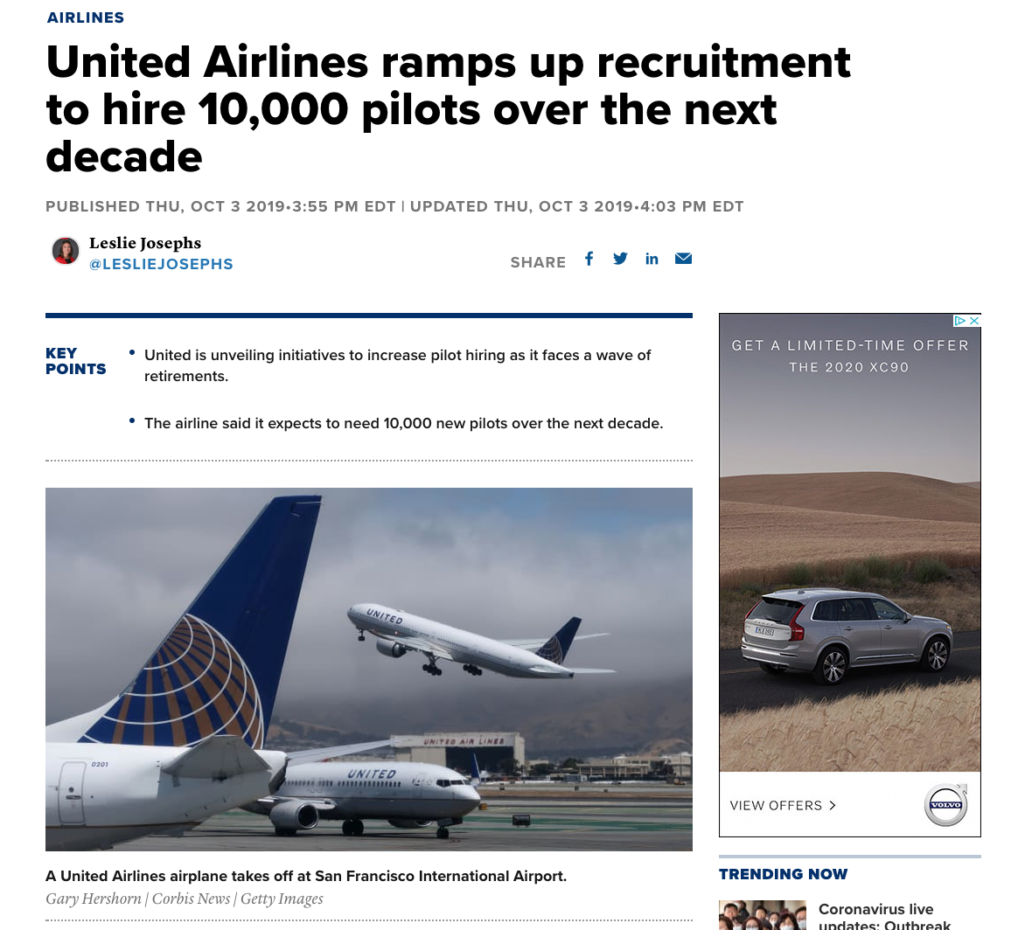

How can we get more pilots?
Notes:
Talk about Cadet programs

Slide 7
Stop Words
Total Words: 1585
Total Words:
2975
Notes:
1 509 tech total words 1585, 2975
1709 fly
2218

Slide 8
How did I test my model?
Model | Vectorizer | Training Score | Testing Score | Cross Validation(3) | Accuracy
Logistic Regression | CountVectorizer | 0.92363 | 0.89189 | .8633 | 0.868
Logistic Regression | TfidVectorizer | 0.89837 | 0.8810 | .8394 | 0.85
MultinomialNB | CountVectorizer | 0.9488 | 0.89909 | .8831 | 0.868
MultinomialNB | TfidVectorizer | 0.90438 | 0.8792 | .8480 | 0.843
Best Model: Logic Regression and tfidVectorizer
Baseline: 0.77
Notes:
lc 560 1, 1
lt 560 1,1
Mt 460, 1,2
Mc 1280, 1,2
BASELINE 0.77

Slide 9
Conclusions
Model can show 90% accuracy
This can help target people who like aviation
Increase awareness of Cadet Program

Slide 10
Sources
https://www.statista.com/topics/4324/the-pilot-shortage/
https://www.cnn.com/travel/article/airline-pilot-shortage-united-states/index.html

